Slide 1


Recona
Analysis of cell composition from tissue expression profiles and identification of infection with lynch syndrome
Supervised by: Dr. Mostafa Kamel

Slide 2
Agenda
Overview
Project Objectives
Datasets
project management style
Design
The used tools
Implementation
summary

Slide 3

Our project aims to identify the specific cell tissue that the sample was conducted from and analysis the sample using machine learning to identify whether the carrier has lynch syndrome or not. our model can identify any sample that are conducted from ascites, pancreas, human brain and mouse brain. the lynch syndrome identification model can check whether the carrier has this syndrome or not through a machine learning model.
Lynch syndrome is due to inherited changes (mutations) in genes that affect DNA mismatch repair, a process that fixes mistakes made when DNA is copied. These genes (MLHL, MSH2, MSH6, PMS2, and EPCAM) normally protect you from getting certain cancers, but some mutations in these genes prevent them from working properly. people with Lynch syndrome are more likely to get colorectal cancer and other cancers, and at a younger age (before 50), According to the Centers of Disease Control and Prevention (CDC), Lynch syndrome causes about 4,200 colorectal cancers and 1,800 uterine (endometrial) cancers per year.
Overview

Slide 4

Our proposed project is supposed to meet these objectives:
identify the specific cell tissue that the sample was conducted from.
identify whether the sample owner has lynch syndrome or not.
Identify the cancer type the sample owner has.
Project Objectives

Slide 5
The used datasets for training the tissue model were real world data conducted from Healthy Donors and the lynch syndrome model was trained on data conducted from lynch syndrome mutation carriers and mutation-free samples provided by pubmed central(PMC).
Datasets

Slide 6

Agile
project management style

Slide 7
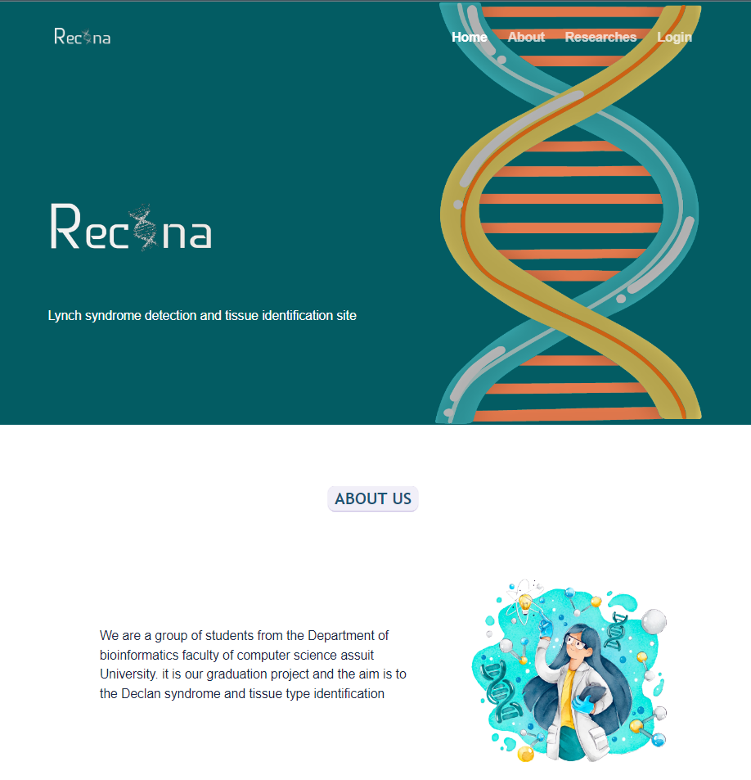
https://www.figma.com/proto/oT8TXTfzPdFdBE8edMTdmj/Graduation-project?page-id=0%3A1&node-id=3%3A2&viewport=-2274%2C1375%2C0.5&scaling=scale-down&starting-point-node-id=3%3A2
Design

Slide 8
deep-learning and machine learning using python
The used tools

Slide 9

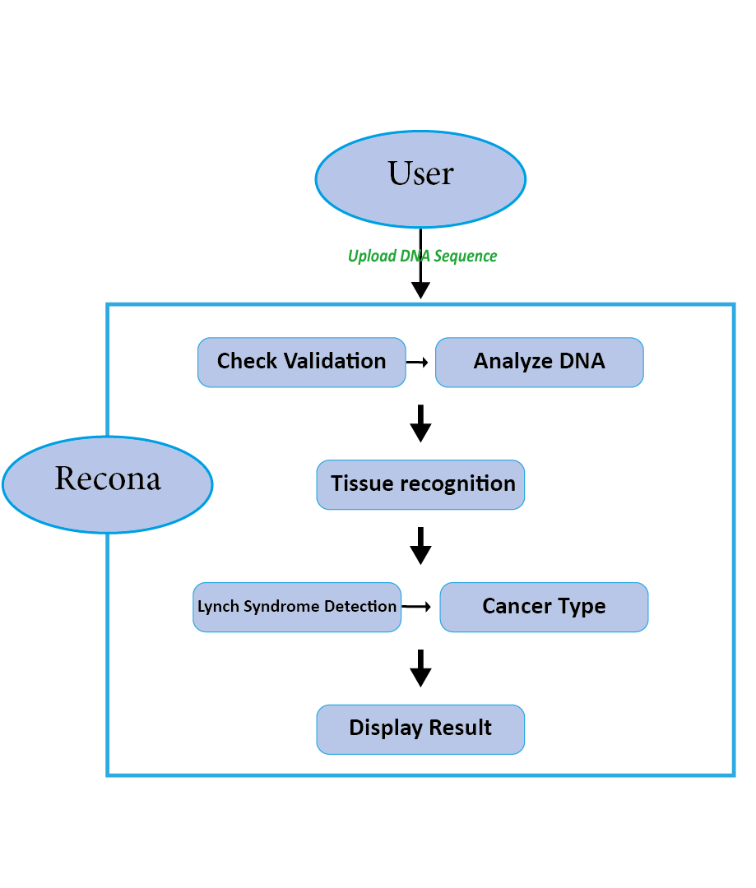
Implementation
(System Architecture)

Slide 10
For the data stored in the database:
storing user information => Login & sin up
a table for storing DNA sequences
a Tissue types and cancer
Implementation
(DataBase)

Slide 11
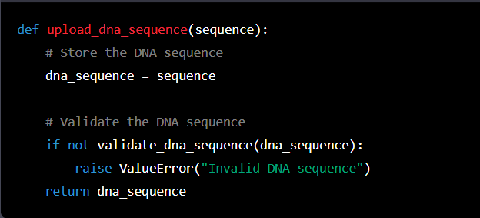
Implementation
(pseudo code)
Upload DNA Sequence

Slide 12
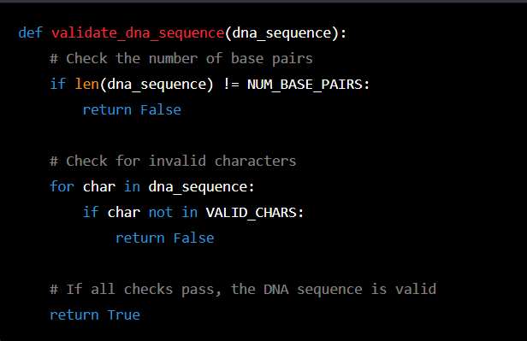
Implementation
(pseudo code)
Validate DNA Sequence

Slide 13
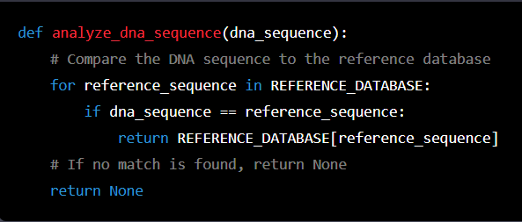
Analyze DNA Sequence
Implementation
(pseudo code)

Slide 14
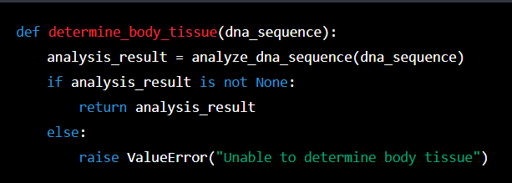
Determine Body Tissue
Implementation
(pseudo code)

Slide 15
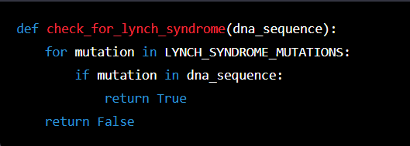
Check for Lynch Syndrome
Implementation
(pseudo code)

Slide 16
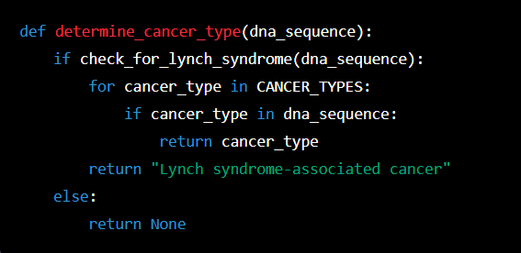
Determine Type of Cancer
Implementation
(pseudo code)

Slide 17
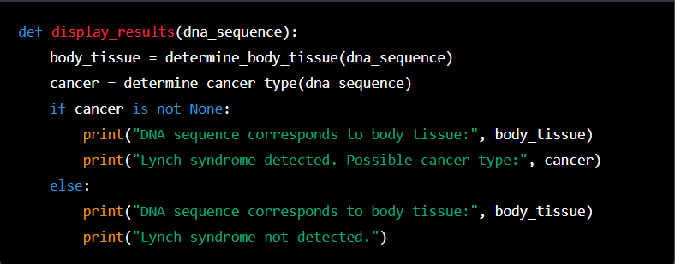
Implementation
(pseudo code)
Display Results

Slide 18
Summary
The website will provide better options for users to search and manipulate their sequence so that they can know the type of tissue they are working on, discover if the owner of the genetic sequence has Lynch syndrome and determine the cancer type if any. Lynch syndrome mutation increases the risk of many types of cancer, especially colon cancer and endometrial cancer. Thus, predicting a patient's risk of developing these cancers is possible.
For future works, we intend to increase the number of tissues that the model can identify and to integrate the 2 models using docker in the backend during the development process.

Slide 19

Mariam Adel Abdelrazik
Amira Emad Abdelhamid
Ayat Saber Mohamed
Marwa Gamal Salman
Marwa Kamal Badri
Maha Mamdouh Adli
Mai Ramadan Mohamed
Team Members

Slide 20
Thank You!

